Slide 1
Promises Using promises in asynchronous programming

Slide 2
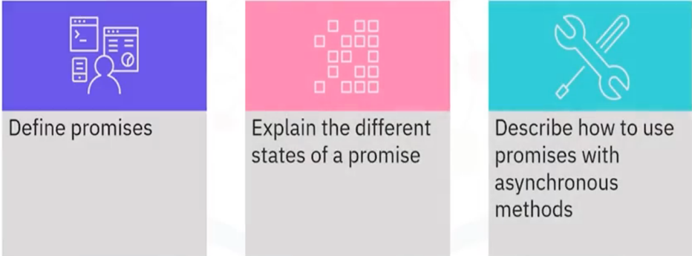
What you will learn

Slide 3
What is a promise?
• An object returned by an asynchronous method
• States: pending, resolved, rejected
• Uses: API requests, I/O operations

Slide 4

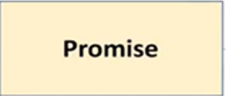


What is a promise?

Slide 5
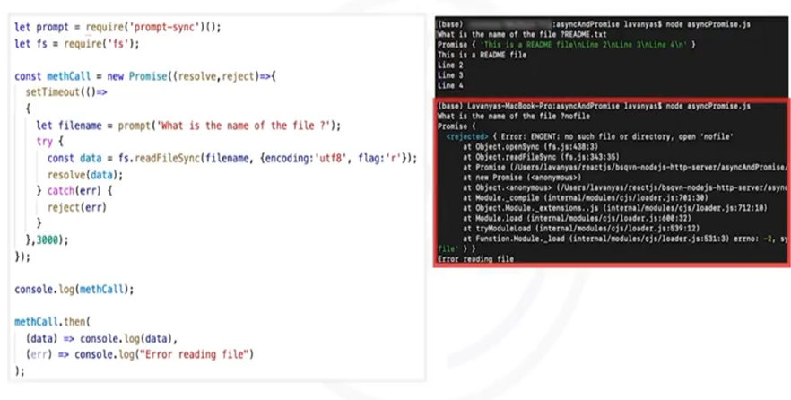
User-defined promise

Slide 6
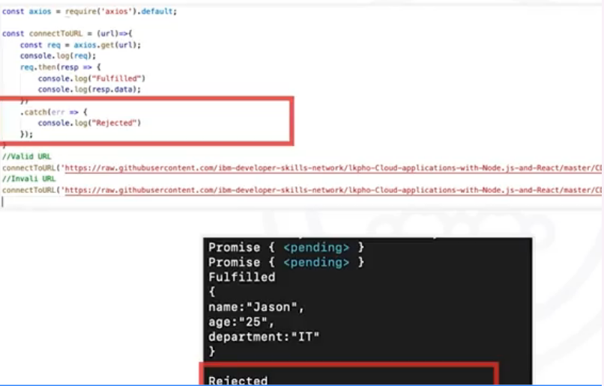
Axios request

Slide 7
Recap
In this video, you learned that:
• A promise is an object that is returned by an asynchronous
method
• The initial state of the promise object is the pending state
• The axios package is used in Node.js to handle HTTP requests

